Slide 1

Graph Algorithms
"A charlatan makes obscure what is clear; a thinker makes clear what is obscure. "
- Hugh Kingsmill
CLRS, Sections 22.2 – 22.4

Slide 2
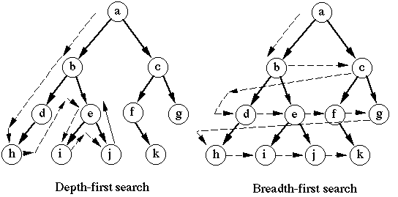
Graph Search
Breadth-First Search (BFS)
Depth-First Search (DFS)

Slide 3
Breadth-First Search
Given a graph G=<V,E> and a source vertex s, breadth-first search explores G’s edges to discover all the vertices reachable from s.
Computes the distance from s to each reachable vertex.
Produces the Breadth-First Tree:
Tree with root s.
Contains all reachable from s and shortest paths between s and these vertices.

Slide 4
BFS Algorithm
The BFS algorithm works for both directed and undirected graphs.
Input is a graph G=<V,E> represented as an adjacency-list and a source or start vertex s in V.
Assumes all vertices reachable from s (i.e. s is connected to all other vertices).
Each BFS node stores several attributes for each vertex in V:
v.color: a color (white, gray, or black)
v.π: the predecessor of v
v.d: the distance from s
It uses a queue during computation.

Slide 5
BFS Node Colors
Meaning of the node color:
gray: nodes that are in the Queue, awaiting processing.
black: nodes that have been dequeued, are processed.
white: unexplored nodes, haven’t been processed.
Node color keeps track of status of a given node.

Slide 6
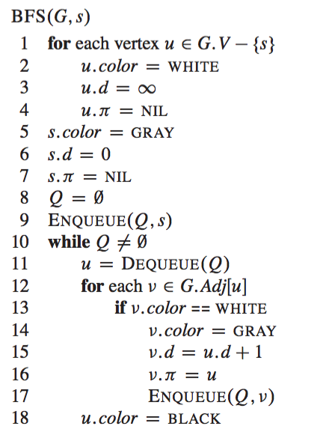
BFS Algorithm

Slide 7
Example: BFS
source node
r
s
t
u
∞
∞
∞
∞
∞
∞
∞
∞
v
w
x
y
The number within the node represents the distance from the source node s

Slide 8
Example: BFS
r
s
t
u
∞
0
s.π=NIL
∞
∞
∞
∞
∞
∞
v
w
x
y
Q:
s

Slide 9
Example: BFS
r
s
t
u
1
r.π=s
0
s.π=NIL
∞
∞
∞
1
∞
∞
w.π=s
v
w
x
y
Q:
w
r

Slide 10
Example: BFS
r
s
t
u
1
r.π=s
0
s.π=NIL
2
t.π=w
∞
∞
1
2
∞
w.π=s
x.π=w
v
w
x
y
Q:
r
t
x

Slide 11
Example: BFS
r
s
t
u
1
r.π=s
0
s.π=NIL
2
t.π=w
∞
2
1
2
∞
v.π=r
w.π=s
x.π=w
v
w
x
y
Q:
t
x
v

Slide 12
Example: BFS
r
s
t
u
1
r.π=s
0
s.π=NIL
2
t.π=w
3
u.π=t
2
1
2
∞
v.π=r
w.π=s
x.π=w
v
w
x
y
Q:
x
v
u

Slide 13
Example: BFS
r
s
t
u
1
r.π=s
0
s.π=NIL
2
t.π=w
3
u.π=t
2
1
2
3
v.π=r
w.π=s
x.π=w
y.π=x
v
w
x
y
Q:
v
u
y

Slide 14
Example: BFS
r
s
t
u
1
r.π=s
0
s.π=NIL
2
t.π=w
3
u.π=t
2
1
2
3
v.π=r
w.π=s
x.π=w
y.π=x
v
w
x
y
Q:
u
y

Slide 15
Example: BFS
r
s
t
u
1
r.π=s
0
s.π=NIL
2
t.π=w
3
u.π=t
2
1
2
3
v.π=r
w.π=s
x.π=w
y.π=x
v
w
x
y
Q:
y

Slide 16
Example: BFS
r
s
t
u
1
r.π=s
0
s.π=NIL
2
t.π=w
3
u.π=t
2
1
2
3
v.π=r
w.π=s
x.π=w
y.π=x
v
w
x
y
Q:
Ø

Slide 17
Example: BFS
root
r
s
t
u
1
r.π=s
0
s.π=NIL
2
t.π=w
3
u.π=t
2
1
2
3
v.π=r
w.π=s
x.π=w
y.π=x
v
w
x
y
Breadth-First Tree
constructed by using the nodes π attribute

Slide 18
Analysis of BFS
O(|V|)
The running time for BFS is O(|V|+|E|), but since connected graph, running time is O(|E|).
O(1)
For each vertex, scan each adjacency list at most once.
Total time for the while loop: O(|E|)
O(|E|)

Slide 19
Computing Shortest Paths
Because BFS discovers all the vertices at the distance k from s before discovering any vertex at distance k+1 from s, BFS can be used to compute length of shortest paths.
If there are multiple paths from s to a vertex u, u will be discovered through the shortest one.

Slide 20
Depth-First Search
Depth-first search is another strategy for exploring a graph:
Explore “deeper” in the graph whenever possible.
An unexplored edge out of the most recently discovered vertex v is explored first.
When all of v’s edges have been explored, backtrack to the predecessor of v.

Slide 21
DFS Algorithm
As with BFS, the DFS algorithm works for both directed and undirected graphs.
Input is a graph G=(V,E) represented as an adjacency-list and a start vertex s in V.
Each DFS node stores several attributes for each vertex in V:
v.color: a color (white, gray, or black)
v.π: the predecessor of v
v.d: time vertex v is first visited
v.f: the time finished processing v

Slide 22
DFS Colors
Meaning of the colors:
gray: when nodes first visited
black: nodes that are done processing
white: unexplored nodes
There is a global variable time.
Assigns timestamps to attributes v.d and v.f.

Slide 23
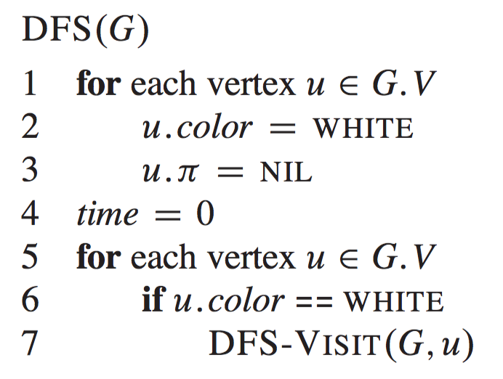
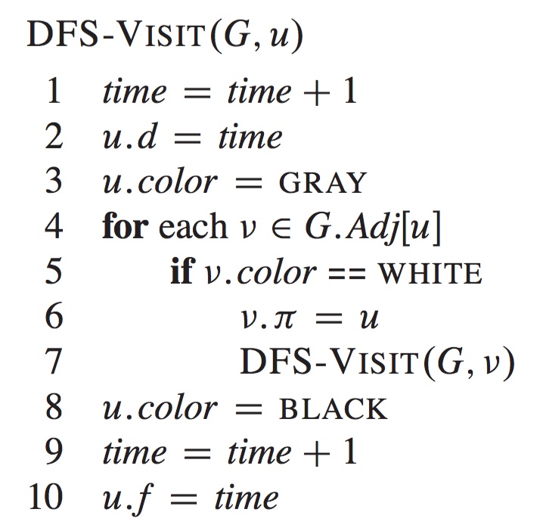
DFS Algorithm

Slide 24
Example: DFS
start vertex
r
s
t
v
u
w
x
y

Slide 25
Example: DFS
r
r.π=NIL
s
t
1 |
|
|
r.d r.f
v
u
|
|
|
|
|
w
x
y

Slide 26
Example: DFS
r
r.π=NIL
s
t
1 |
|
|
v
u
2 |
|
v.π=r
|
|
|
w
x
y

Slide 27
Example: DFS
r
r.π=NIL
s
t
1 |
|
|
v
u
2 |
|
v.π=r
3 |
|
|
w
w.π=v
x
y

Slide 28
Example: DFS
r
r.π=NIL
s
t
1 |
|
|
v
u
2 |
|
v.π=r
3 | 4
|
|
w
w.π=v
x
y

Slide 29
Example: DFS
r
r.π=NIL
s
t
1 |
|
|
v
u
2 |
|
v.π=r
3 | 4
5 |
|
w
w.π=v
x
x.π=v
y

Slide 30
Example: DFS
r
r.π=NIL
s
t
1 |
|
|
v
u
2 |
|
v.π=r
3 | 4
5 | 6
|
w
w.π=v
x
x.π=v
y

Slide 31
Example: DFS
r
r.π=NIL
s
t
1 |
1 |
|
|
|
v
u
2 | 7
|
|
v.π=r
3 | 4
5 | 6
3 | 4
5 | 6
|
|
w
w.π=v
x
x.π=v
y

Slide 32
Example: DFS
r
r.π=NIL
s
s.π=r
t
1 |
1 |
8 |
|
|
v
u
2 | 7
|
|
v.π=r
3 | 4
5 | 6
3 | 4
5 | 6
|
|
w
w.π=v
x
x.π=v
y

Slide 33
Example: DFS
r
r.π=NIL
s
s.π=r
t
1 |
8 |
|
v
u
2 | 7
9 |
v.π=r
u.π=s
3 | 4
5 | 6
|
w
w.π=v
x
x.π=v
y

Slide 34
Example: DFS
r
r.π=NIL
s
s.π=r
t
1 |
8 |
|
v
u
2 | 7
9 |10
v.π=r
u.π=s
3 | 4
5 | 6
|
w
w.π=v
x
x.π=v
y

Slide 35
Example: DFS
r
r.π=NIL
s
s.π=r
t
1 |
8 |11
|
v
u
2 | 7
9 |10
v.π=r
u.π=s
3 | 4
5 | 6
|
w
w.π=v
x
x.π=v
y

Slide 36
Example: DFS
r
r.π=NIL
s
s.π=r
t
1 |12
8 |11
|
v
u
2 | 7
9 |10
v.π=r
u.π=s
3 | 4
5 | 6
|
w
w.π=v
x
x.π=v
y

Slide 37
Example: DFS
new start vertex
r
r.π=NIL
s
s.π=r
t
t.π=NIL
1 |12
8 |11
13|
v
u
2 | 7
9 |10
v.π=r
u.π=s
3 | 4
5 | 6
|
w
w.π=v
x
x.π=v
y

Slide 38
Example: DFS
r
r.π=NIL
s
s.π=r
t
t.π=NIL
1 |12
8 |11
13|
v
u
2 | 7
9 |10
v.π=r
u.π=s
3 | 4
5 | 6
14|
w
w.π=v
x
x.π=v
y
y.π=t

Slide 39
Example: DFS
r
r.π=NIL
s
s.π=r
t
t.π=NIL
1 |12
8 |11
13|
v
u
2 | 7
9 |10
v.π=r
u.π=s
3 | 4
5 | 6
14|15
w
w.π=v
x
x.π=v
y
y.π=t

Slide 40
Example: DFS
r
r.π=NIL
s
s.π=r
t
t.π=NIL
1 |12
8 |11
13|16
v
u
2 | 7
9 |10
v.π=r
u.π=s
3 | 4
5 | 6
14|15
w
w.π=v
x
x.π=v
y
y.π=t

Slide 41
Depth-First Search Properties
The predecessor sub-graph:
Constructed using the predecessor attribute π, of the nodes.
Forms the depth-first forest - set of trees because the search may be repeated from multiple sources.

Slide 42
Example: DFS Forest
r
r.π=NIL
s
s.π=r
t
t.π=NIL
1 |12
8 |11
13|16
v
u
2 | 7
9 |10
v.π=r
u.π=s
3 | 4
5 | 6
14|15
w
w.π=v
x
x.π=v
y
y.π=t

Slide 43
Depth-First Search Properties
Discovering and finishing times have parenthesis structure.
As soon as we assign the attribute d to a node v we write (d .
As soon as we assign the attribute f to a node v we write f) .

Slide 44
Example: Parenthesis Structure
(1
r
r.π=NIL
s
t
1 |
|
|
r.d r.f
v
u
|
|
|
|
|
w
x
y

Slide 45
Example: Parenthesis Structure
(1 (2
r
r.π=NIL
s
t
1 |
|
|
v
u
2 |
|
v.π=r
|
|
|
w
x
y

Slide 46
Example: Parenthesis Structure
(1 (2 (3
r
r.π=NIL
s
t
1 |
|
|
v
u
2 |
|
v.π=r
3 |
|
|
w
w.π=v
x
y

Slide 47
Example: Parenthesis Structure
(1 (2 (3 4)
r
r.π=NIL
s
t
1 |
|
|
v
u
2 |
|
v.π=r
3 | 4
|
|
w
w.π=v
x
y

Slide 48
Example: Parenthesis Structure
(1 (2 (3 4) (5
r
r.π=NIL
s
t
1 |
|
|
v
u
2 |
|
v.π=r
3 | 4
5 |
|
w
w.π=v
x
x.π=v
y

Slide 49
Example: Parenthesis Structure
(1 (2 (3 4) (5 6)
r
r.π=NIL
s
t
1 |
|
|
v
u
2 |
|
v.π=r
3 | 4
5 | 6
|
w
w.π=v
x
x.π=v
y

Slide 50
Example: Parenthesis Structure
(1 (2 (3 4) (5 6) 7)
r
r.π=NIL
s
t
1 |
1 |
|
|
|
v
u
2 | 7
|
|
v.π=r
3 | 4
5 | 6
3 | 4
5 | 6
|
|
w
w.π=v
x
x.π=v
y

Slide 51
Example: Parenthesis Structure
(1 (2 (3 4) (5 6) 7) (8
r
r.π=NIL
s
s.π=r
t
1 |
1 |
8 |
|
|
v
u
2 | 7
|
|
v.π=r
3 | 4
5 | 6
3 | 4
5 | 6
|
|
w
w.π=v
x
x.π=v
y

Slide 52
Example: Parenthesis Structure
(1 (2 (3 4) (5 6) 7) (8 (9
r
r.π=NIL
s
s.π=r
t
1 |
8 |
|
v
u
2 | 7
9 |
v.π=r
u.π=s
3 | 4
5 | 6
|
w
w.π=v
x
x.π=v
y

Slide 53
Example: Parenthesis Structure
(1 (2 (3 4) (5 6) 7) (8 (9 10)
r
r.π=NIL
s
s.π=r
t
1 |
8 |
|
v
u
2 | 7
9 |10
v.π=r
u.π=s
3 | 4
5 | 6
|
w
w.π=v
x
x.π=v
y

Slide 54
Example: Parenthesis Structure
(1 (2 (3 4) (5 6) 7) (8 (9 10) 11)
r
r.π=NIL
s
s.π=r
t
1 |
8 |11
|
v
u
2 | 7
9 |10
v.π=r
u.π=s
3 | 4
5 | 6
|
w
w.π=v
x
x.π=v
y

Slide 55
Example: Parenthesis Structure
(1 (2 (3 4) (5 6) 7) (8 (9 10) 11) 12)
r
r.π=NIL
s
s.π=r
t
1 |12
8 |11
|
v
u
2 | 7
9 |10
v.π=r
u.π=s
3 | 4
5 | 6
|
w
w.π=v
x
x.π=v
y

Slide 56
Example: Parenthesis Structure
(1 (2 (3 4) (5 6) 7) (8 (9 10) 11) 12) (13
r
r.π=NIL
s
s.π=r
t
t.π=NIL
1 |12
8 |11
13|
v
u
2 | 7
9 |10
v.π=r
u.π=s
3 | 4
5 | 6
|
w
w.π=v
x
x.π=v
y

Slide 57
Example: Parenthesis Structure
(1 (2 (3 4) (5 6) 7) (8 (9 10) 11) 12) (13 (14
r
r.π=NIL
s
s.π=r
t
t.π=NIL
1 |12
8 |11
13|
v
u
2 | 7
9 |10
v.π=r
u.π=s
3 | 4
5 | 6
14|
w
w.π=v
x
x.π=v
y
y.π=t

Slide 58
Example: Parenthesis Structure
(1 (2 (3 4) (5 6) 7) (8 (9 10) 11) 12) (13 (14 15)
r
r.π=NIL
s
s.π=r
t
t.π=NIL
1 |12
8 |11
13|
v
u
2 | 7
9 |10
v.π=r
u.π=s
3 | 4
5 | 6
14|15
w
w.π=v
x
x.π=v
y
y.π=t

Slide 59
Example: Parenthesis Structure
(1 (2 (3 4) (5 6) 7) (8 (9 10) 11) 12) (13 (14 15) 16)
r
r.π=NIL
s
s.π=r
t
t.π=NIL
1 |12
8 |11
13|16
v
u
2 | 7
9 |10
v.π=r
u.π=s
3 | 4
5 | 6
14|15
w
w.π=v
x
x.π=v
y
y.π=t

Slide 60
Depth-first Search Properties
(1 (2 (3 4) (5 6) 7) (8 (9 10) 11) 12) (13 (14 15) 16)
A node u is a descendent of a node v in the DFS forest iff the interval (u.d,u.f) is contained in the interval (v.d,v.f), i.e. v.d < u.d < u.f < v.f
Node u is unrelated to node v in the DFS forest iff the intervals (u.d,u.f) and (v.d,v.f) are disjoint, i.e. u.f < v.d OR v.f < u.d
e.g. nodes w and x are unrelated

Slide 61
Analysis of DFS
O(|V|)
O(1)
O(|E|)
The DFS running time is Θ(|V|+|E|), because there’s no requirement that the graph be connected.

Slide 62
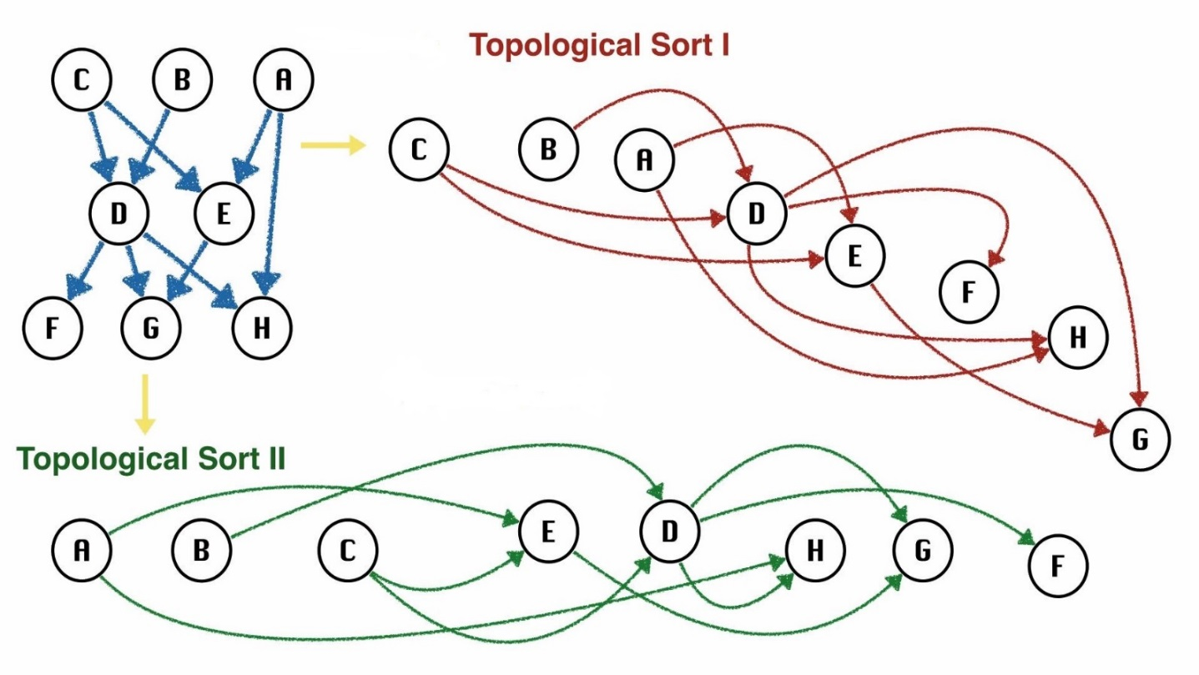
Topological Sort

Slide 63
Class Prerequisites
Consider part-time student planning schedule.
Must take the following 10 required courses with the given prerequisites:
Can take classes in any order, if prerequisite met.
Can only take one class a semester.
What order should the classes be taken?
142 | 143 | 321 | 322 | 326 | 341 | 370 | 378 | 401 | 421
none | 142 | 143 | 321 | 321 | 143 | 143 | 143 | 322 | 322
 |  |  |  |  |  |  |  | 326 | 326
 |  |  |  |  |  |  |  | 341
 |  |  |  |  |  |  |  | 378

Slide 64
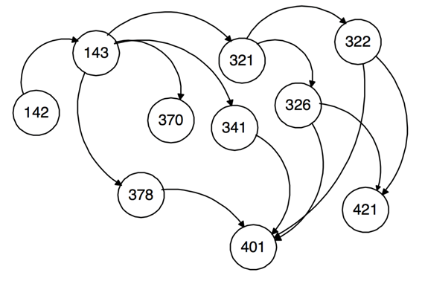
Graph Modelling
Model problem as a directed, acyclic graph (DAG):
nodes represent courses.
contains an edge (u, v) if course u is a prerequisite of course v.
Use topological sort to determine order to take classes.

Slide 65
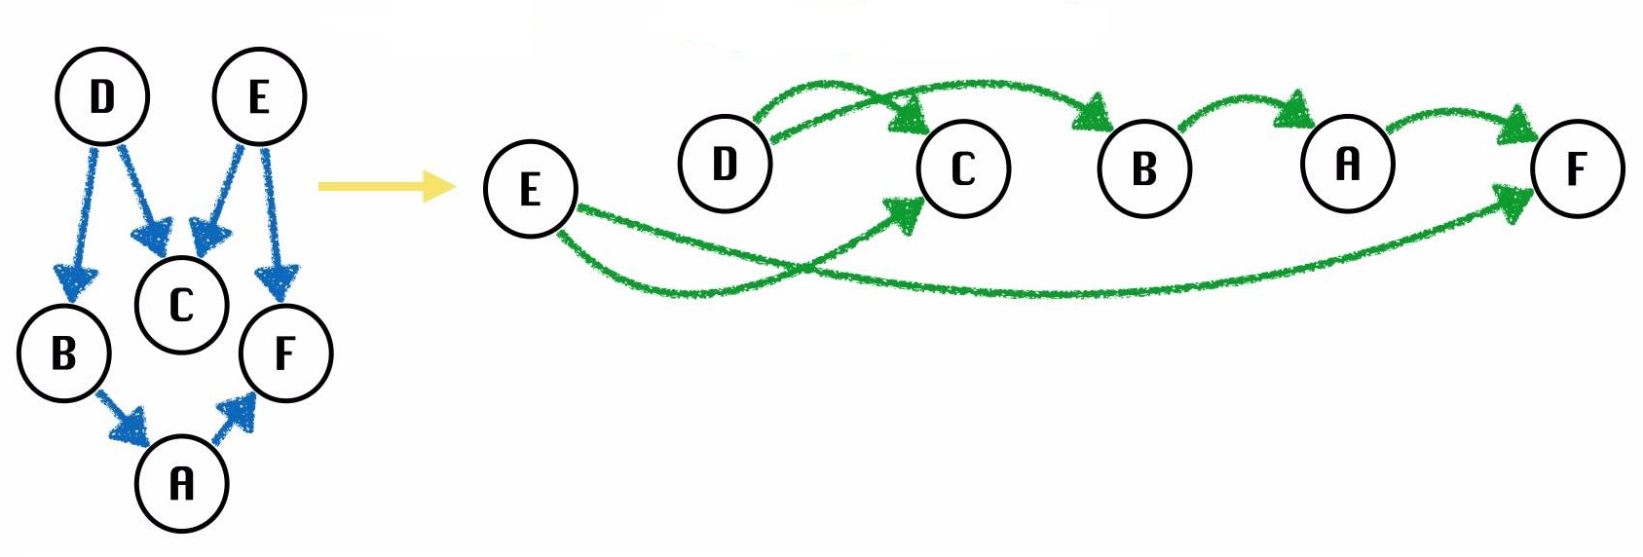
Topological Sort
Topological sorting problem:
Given directed acyclic graph (DAG) G = <V, E> ,
Find a linear ordering of vertices such that for any edge (u, v) in E, u precedes v in the ordering.
May be more than one ordering.
Topological Sort

Slide 66
Simple Topological Sort Algorithm
Identify vertices with no incoming edges.
The in-degree of these vertices is zero.
If no vertices with no incoming edges,
Graph is not acyclic.
Doesn’t have a topological ordering.
Remove one of these vertices and its edges from the graph.
Return this vertex.
Repeat until graph is empty.
Order vertices are returned is topological ordering.

Slide 67
Example: Simple Topological Sort
322
Identify vertices with no incoming edges.
321
421
326
142
143
341
401
370
Only vertex with no incoming edges
378

Slide 68
Example: Simple Topological Sort
322
Remove vertex and its edges.
321
421
326
143
341
401
370
378
Output:
142

Slide 69
Example: Simple Topological Sort
322
Identify vertices with no incoming edges.
321
421
326
143
341
401
Only vertex with no incoming edges
370
378
Output:
142

Slide 70
Example: Simple Topological Sort
322
Remove vertex and its edges.
321
421
326
341
401
370
378
Output:
142 143

Slide 71
Example: Simple Topological Sort
322
Identify vertices with no incoming edges.
321
421
326
Four vertices with no incoming edges.
Select one.
341
401
370
378
Output:
142 143

Slide 72
Example: Simple Topological Sort
322
Remove vertex and its edges.
421
326
341
401
370
378
Output:
142 143 321

Slide 73
Example: Simple Topological Sort
322
Identify vertices with no incoming edges.
421
326
Five vertices with no incoming edges.
Select one.
341
401
370
378
Output:
142 143 321

Slide 74
Example: Simple Topological Sort
322
Remove vertex and its edges.
421
326
401
370
378
Output:
142 143 321 341

Slide 75
Example: Simple Topological Sort
322
Identify vertices with no incoming edges.
421
326
Four vertices with no incoming edges.
Select one.
401
370
378
Output:
142 143 321 341

Slide 76
Example: Simple Topological Sort
322
Remove vertex and its edges.
421
326
401
378
Output:
142 143 321 341 370

Slide 77
Example: Simple Topological Sort
322
Identify vertices with no incoming edges.
421
326
Three vertices with no incoming edges.
Select one.
401
378
Output:
142 143 321 341 370

Slide 78
Example: Simple Topological Sort
322
Remove vertex and its edges.
421
326
401
Output:
142 143 321 341 370 378

Slide 79
Example: Simple Topological Sort
322
Identify vertices with no incoming edges.
421
326
Two vertices with no incoming edges.
Select one.
401
Output:
142 143 321 341 370 378

Slide 80
Example: Simple Topological Sort
Remove vertex and its edges.
421
326
401
Output:
142 143 321 341 370 378 322

Slide 81
Example: Simple Topological Sort
Identify vertices with no incoming edges.
421
326
Only vertex with no incoming edge.
401
Output:
142 143 321 341 370 378 322

Slide 82
Example: Simple Topological Sort
Remove vertex and its edges.
421
401
Output:
142 143 321 341 370 378 322 326

Slide 83
Example: Simple Topological Sort
Identify vertices with no incoming edges.
421
Two vertices with no incoming edges.
Select one.
401
Output:
142 143 321 341 370 378 322 326

Slide 84
Example: Simple Topological Sort
Remove vertex and its edges.
401
Output:
142 143 321 341 370 378 322 326 421

Slide 85
Example: Simple Topological Sort
Identify vertices with no incoming edges.
Only vertex with no incoming edges.
401
Output:
142 143 321 341 370 378 322 326 421

Slide 86
Example: Simple Topological Sort
Remove vertex and its edges.
Output:
142 143 321 341 370 378 322 326 421 401

Slide 87
Example: Simple Topological Sort
Therefore, the student can take the classes in this order:
142 143 321 341 370 378 322 326 421 401
There are many other possible orderings, depending how choose which vertex to remove if there’s more than one with no incoming edges.

Slide 88
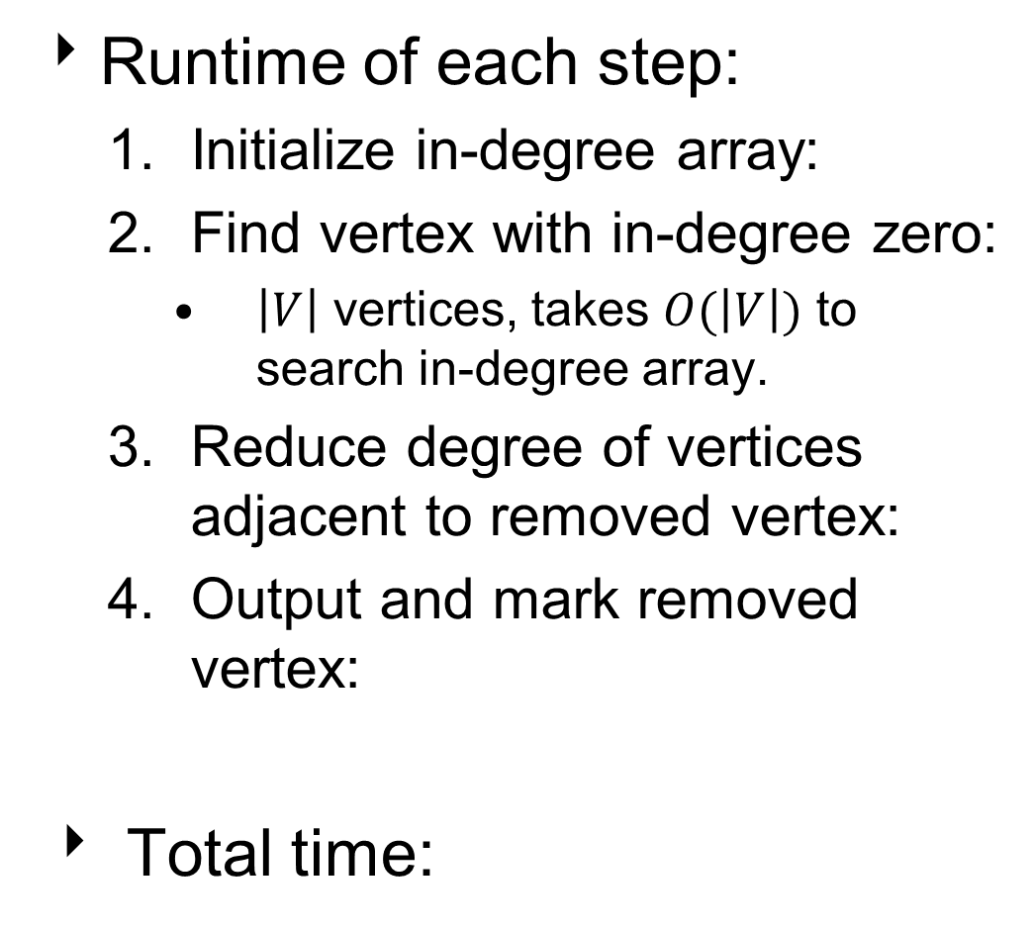
Analysis of Simple Topological Sort
Runtime of each step:
Initialize in-degree array:
Find vertex with in-degree zero:
$\left|V\right|$ vertices, takes $O(\left|V\right|)$ to search in-degree array.
Reduce degree of vertices adjacent to removed vertex:
Output and mark removed vertex:
Total time:

Slide 89

Analysis of Simple Topological Sort
Runtime of each step:
Initialize in-degree array:
Find vertex with in-degree zero:
$\left|V\right|$ vertices, takes $O(\left|V\right|)$ to search in-degree array.
Reduce degree of vertices adjacent to removed vertex:
Output and mark removed vertex:
Total time:
$O(\left|E\right|)$

Slide 90

Analysis of Simple Topological Sort
Runtime of each step:
Initialize in-degree array:
Find vertex with in-degree zero:
$\left|V\right|$ vertices, takes $O(\left|V\right|)$ to search in-degree array.
Reduce degree of vertices adjacent to removed vertex:
Output and mark removed vertex:
Total time:
$O(\left|E\right|)$
$O({\left|V\right|}^{2})$

Slide 91

Analysis of Simple Topological Sort
Runtime of each step:
Initialize in-degree array:
Find vertex with in-degree zero:
$\left|V\right|$ vertices, takes $O(\left|V\right|)$ to search in-degree array.
Reduce degree of vertices adjacent to removed vertex:
Output and mark removed vertex:
Total time:
$O(\left|E\right|)$
$O({\left|V\right|}^{2})$
$O(\left|E\right|)$

Slide 92

Analysis of Simple Topological Sort
Runtime of each step:
Initialize in-degree array:
Find vertex with in-degree zero:
$\left|V\right|$ vertices, takes $O(\left|V\right|)$ to search in-degree array.
Reduce degree of vertices adjacent to removed vertex:
Output and mark removed vertex:
Total time:
$O(\left|E\right|)$
$O({\left|V\right|}^{2})$
$O(\left|E\right|)$
$O(\left|V\right|)$

Slide 93
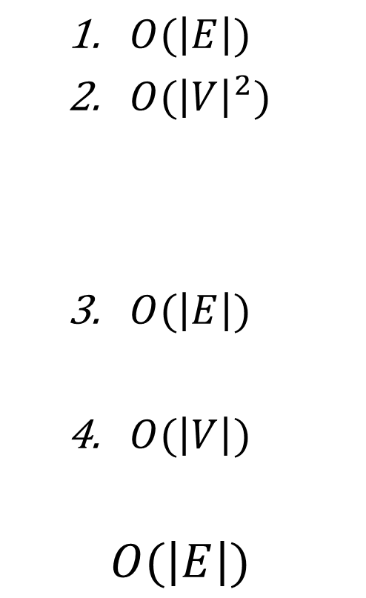
Analysis of Simple Topological Sort
Runtime of each step:
Initialize in-degree array:
Find vertex with in-degree zero:
$\left|V\right|$ vertices, takes $O(\left|V\right|)$ to search in-degree array.
Reduce degree of vertices adjacent to removed vertex:
Output and mark removed vertex:
Total time:
$O(\left|E\right|)$
$O({\left|V\right|}^{2})$
$O(\left|E\right|)$
$O(\left|V\right|)$
$$O(\left|E\right|)$$

Slide 94
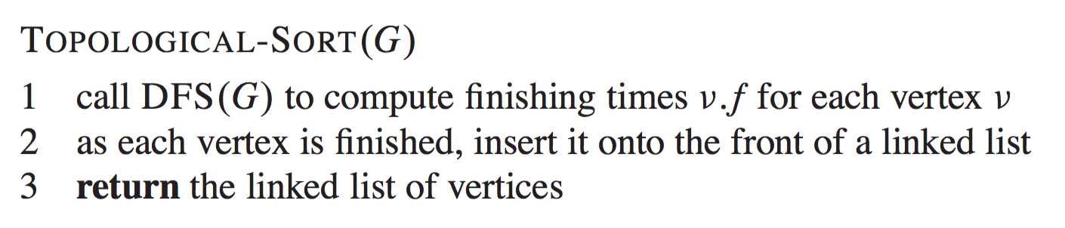
Topological Sort with DFS
The topological sort of a DAG G can by computed by leveraging the DFS algorithm.

Slide 95
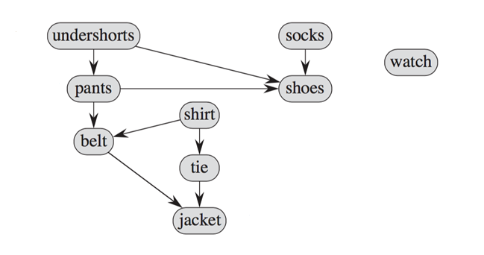
Example: TS with DFS
Modelling the order a person can dress:

Slide 96
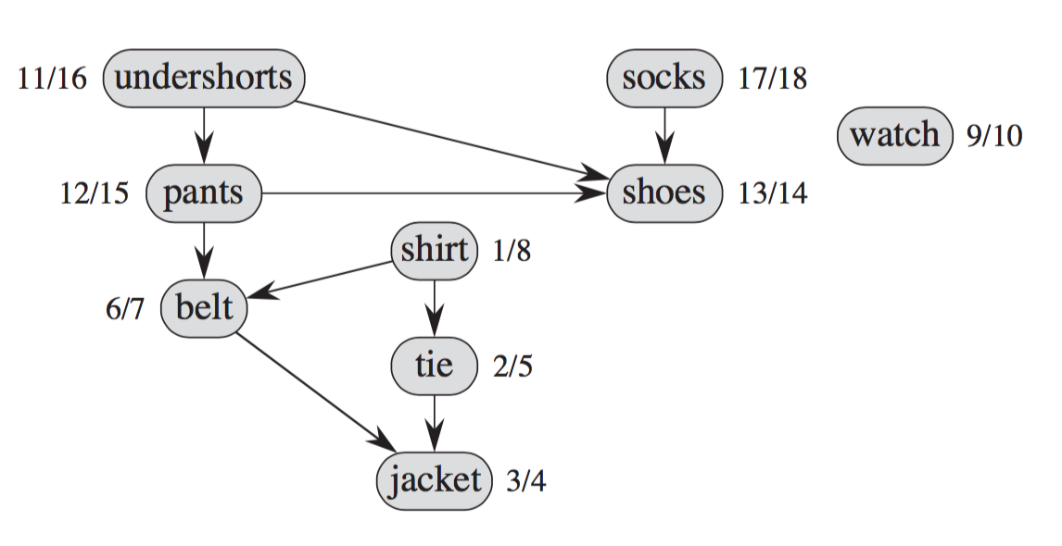
Example: TS with DFS
The v.d and v.f times for the items after complete DFS.

Slide 97
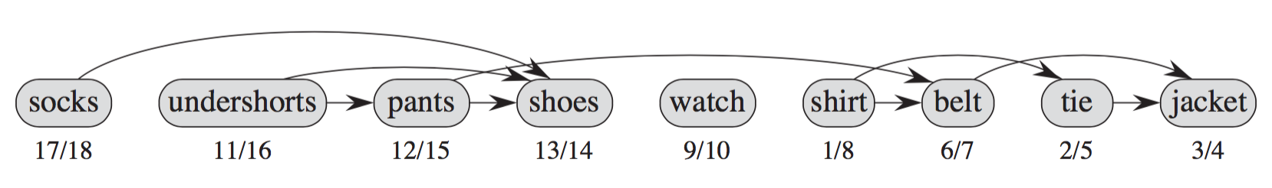
Example: TS with DFS
Add items to list as finish each one.
Topological Sort

Slide 98
Analysis of Topological Sort with DFS
Runtime of each step:
DFS(G):
Add vertex to front of list:
Return list:
Total time:

Slide 99

Analysis of Topological Sort with DFS
Runtime of each step:
DFS(G):
Add vertex to front of list:
Return list:
Total time:
$O(\left|V\right|+\left|E\right|)$

Slide 100

Analysis of Topological Sort with DFS
Runtime of each step:
DFS(G):
Add vertex to front of list:
Return list:
Total time:
$O(\left|V\right|+\left|E\right|)$
$O(1)$

Slide 101

Analysis of Topological Sort with DFS
Runtime of each step:
DFS(G):
Add vertex to front of list:
Return list:
Total time:
$O(\left|V\right|+\left|E\right|)$
$O(1)$
$O(1)$

Slide 102

Analysis of Topological Sort with DFS
Runtime of each step:
DFS(G):
Add vertex to front of list:
Return list:
Total time:
$O(\left|V\right|+\left|E\right|)$
$O(1)$
$O(1)$
$$O(\left|V\right|+\left|E\right|)$$

